Slide 1
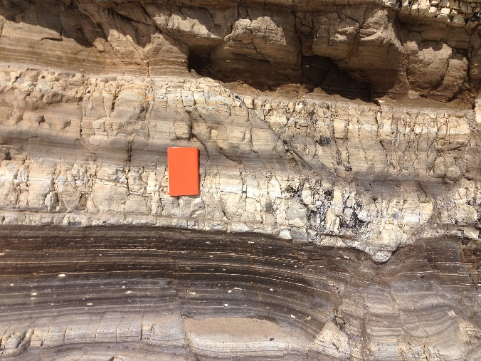
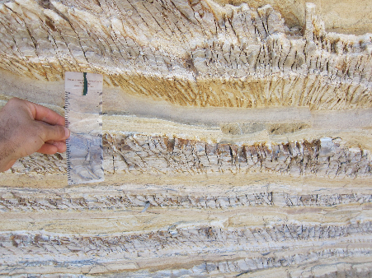
Compositional and Diagenetic Controls of Hardness; Implications for Fracture Development
Upper Monterey Formation, Belridge Oil Field, San Joaquin Valley, California
By: Ryan Weller
Committee: Richard Behl, Jon Schwalbach, and Tom Kelty
MARS Project, CSULB, Geological Sciences

Slide 2
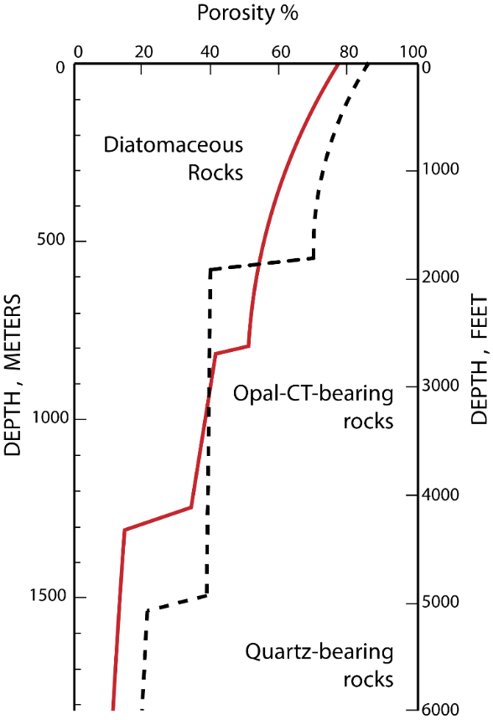
Monterey Formation - Diagenesis
Highly contrasting physical properties via compositional and diagenetic variability

Slide 3
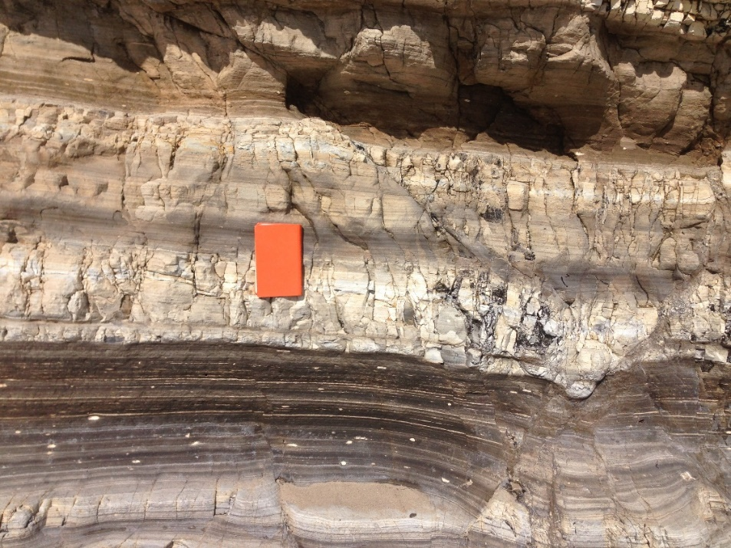
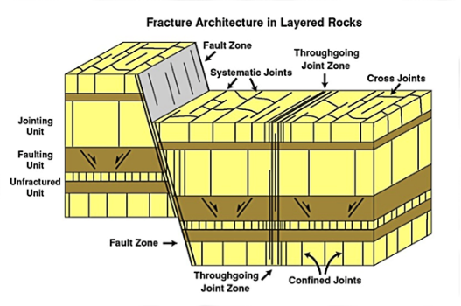
Mechanical Stratigraphy
Composition + diagenesis + bed thickness + structural position =
Varied fracture style and density (Mechanical Stratigraphy)
Arroyo Burro Beach, CA
Gross, 1995
Notes:
Great physical contrasts lead to heterogeneous and anisotropic mechanics
Outcrops show BOLD and Distinct Fracture stratigraphy based on comp, bed, position..

Slide 4
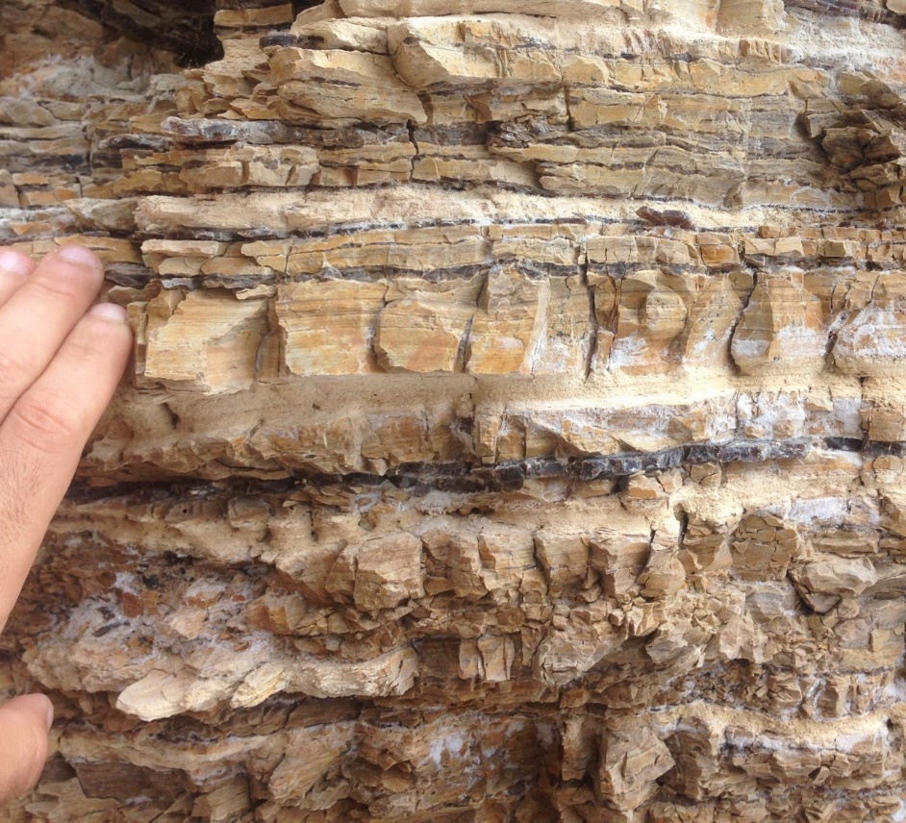
Hypothesis and Goals
Mechanical properties are strongly influenced by composition and silica diagenesis.
Test a wide range of subsurface core at a high resolution to quantify:
Composition
Diagenesis
Physical properties (porosity)
Mechanical properties (rebound hardness and UCS)

Slide 5
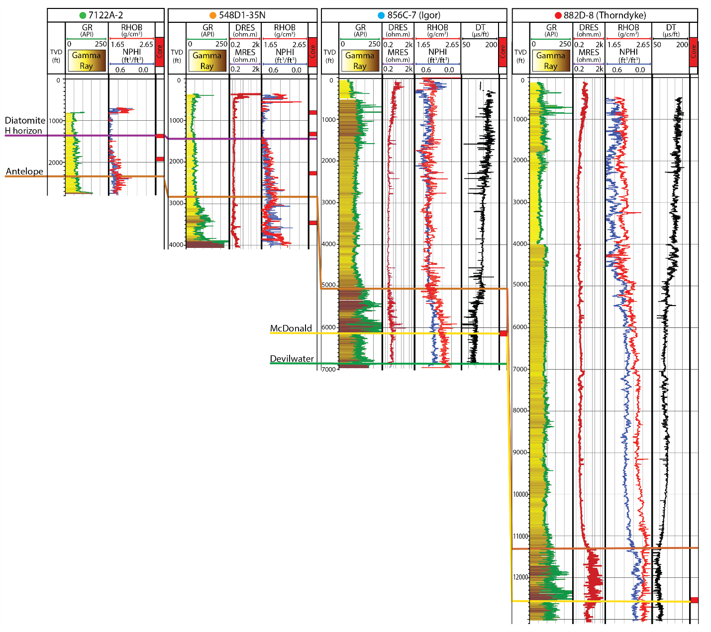
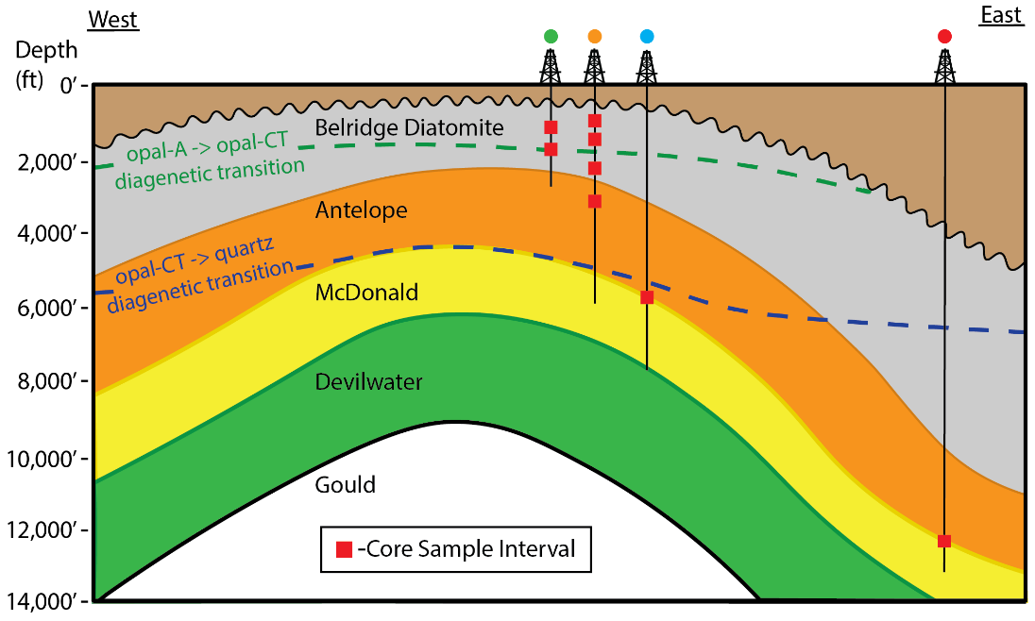
Methods – Belridge Oilfield
A-CT
CT-QTZ
Notes:
Ccore and well data from Aera Energy at the Belridge Oilfield,
used well logs to identify diagenetic transition zones by density and porosity shifts
Selected core samples from correlative horizons at different burial depths.
4 Wells (over 80 ft of core)
Compositionally diverse
Diagenetically contrasting
Stratigraphically similar horizons
Identify diagenetic shifts in wireline
The most interesting core we were excited to consider were two cored wells that test the same quartz phase interval at the top of the McDonald at 6k and 12k feet.

Slide 6
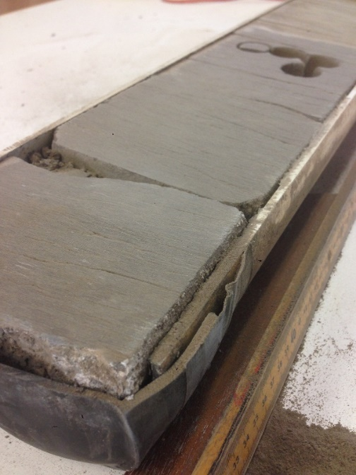
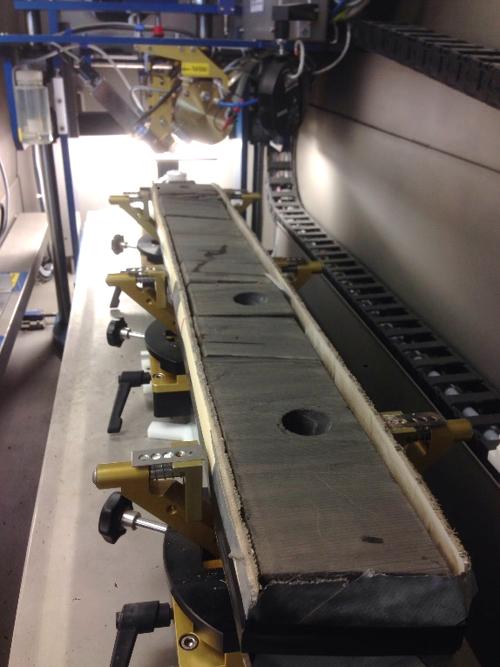
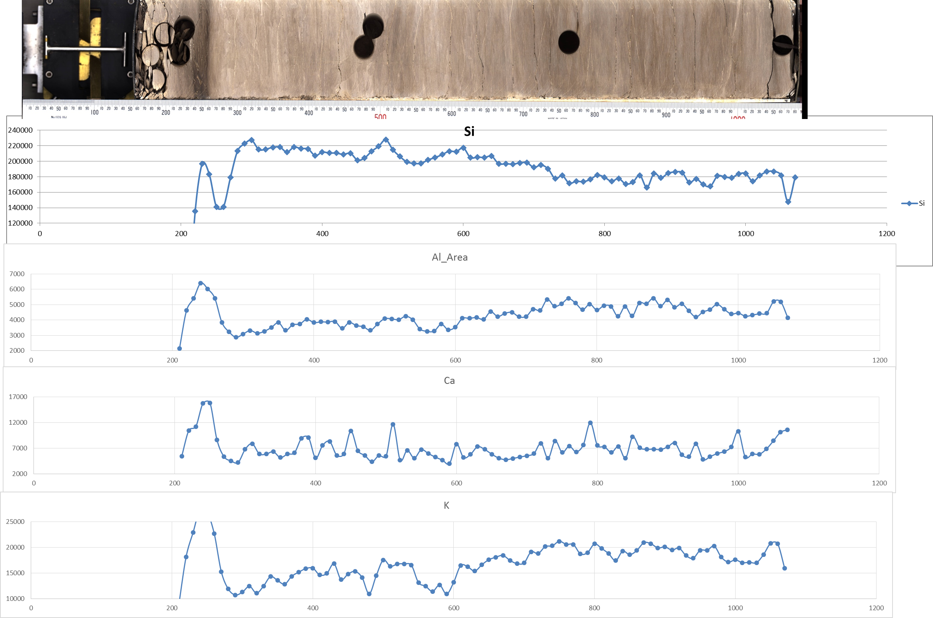
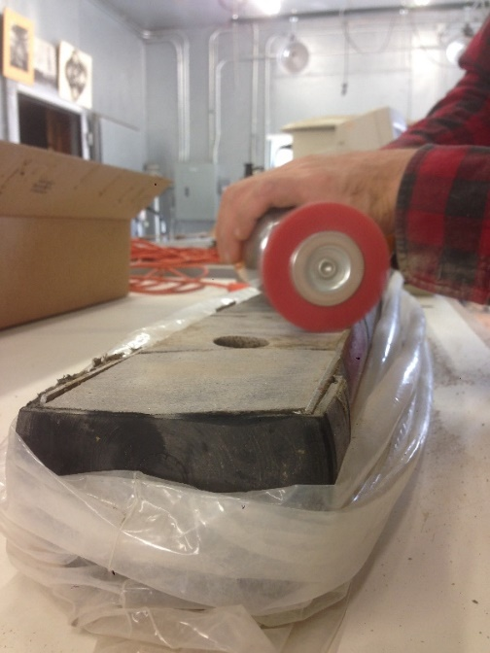
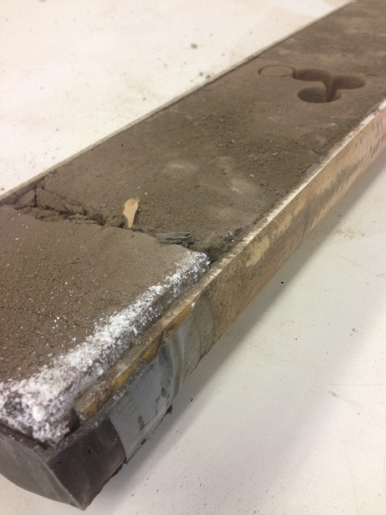
Methods – XRF Scanning
X-Ray Fluorescence
Clean
Scan
Results
Si
Al
Ca
K
1 cm² resolution
Qualitative Elemental Analysis of Al, Si, P, S, Cl, K, Ca, Ti, Cr, Mn, and Fe
Over 27,500 XRF data points
Notes:
Cleaned the 2/3 sections that were often filthy with this crust of degraded surface and mineral precip
Scanned at Scripps Institution of Oceanography at 1cm

Slide 7
Silica:Detritus Definition
XRF Corrected for elemental fluorescence yield and normalized to total counts
Inductively Coupled Plasma – Mass Spectrometry (ICP-MS)
  25 samples analyzed 8 elemental oxides – correlated to XRF
Covert Oxides to Normalize Si:Detritus (Isaacs, 1980)
  Biogenic and Diagenetic Silica % = SiO₂ – (3.5x Al₂O₃)
  Detritus % = 5.6 x Al₂O₃

Slide 8
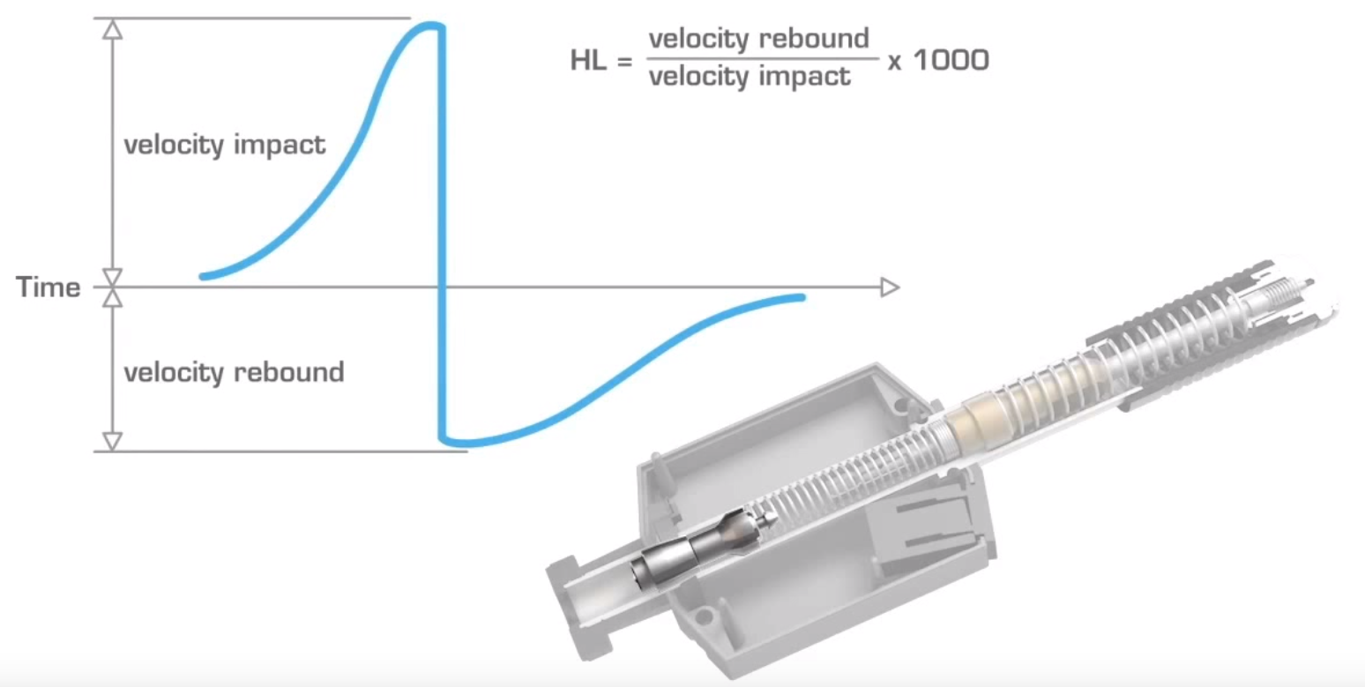
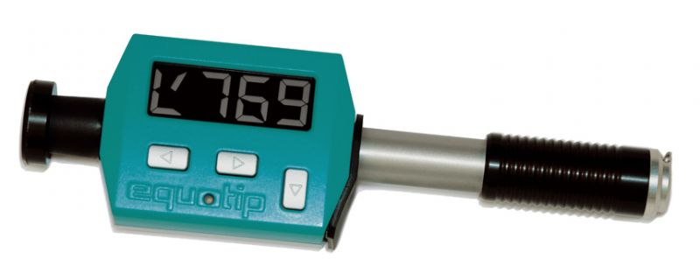
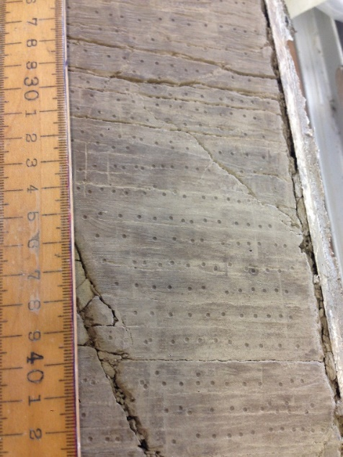
Methods – Leeb Hardness (HLD)
Proceq Piccolo Rebound Hardness tester
12,500 total measurement
Average of 5-7 of the highest values
w/ suspected errors removed
  1,546 HLD data points
6.5 inches
Notes:
Leeb hardness testing
NOT MOHs scale of hardness – like glass plates, pocket knives and pennies
But a fast and precise Non Destructive testing
Tungsten carbide probe, sprung against the surface
Carries a relationship to Youngs Modulus and calibrated conversion to UCS

Slide 9
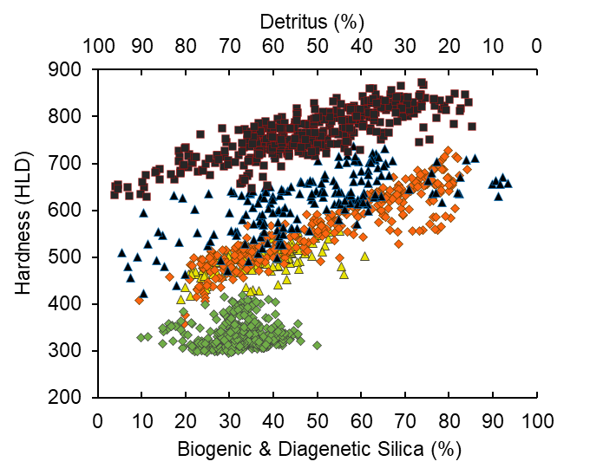
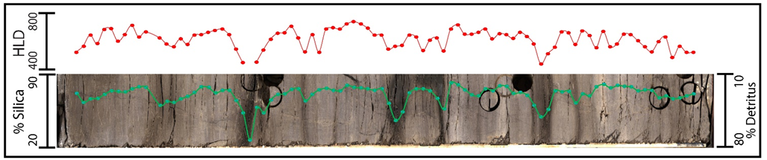
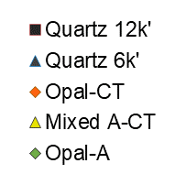
Hardness Results
Length 3.2ft
Increasing Silica = Increasing Hardness
Significant trends
Limited Opal-A results
Notes:
Mixed A-CT = 13% opal-A and 87% opal-CT

Slide 10
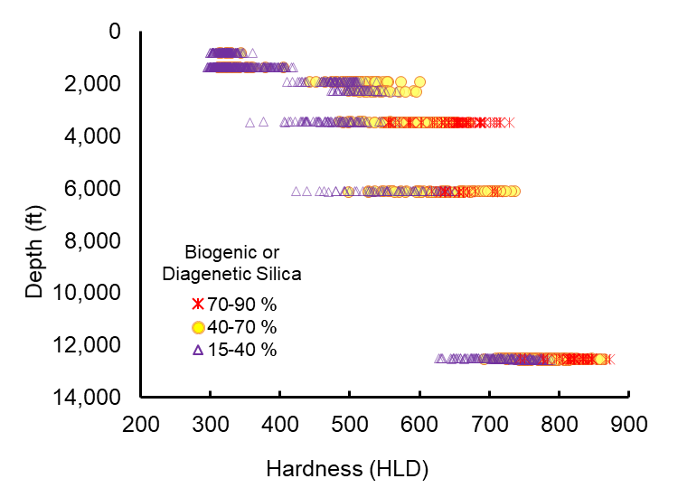
Results – Hardness in Depth
Tremendous variance
Significant overlap
Stepwise shifts with diagenesis
12k’ Quartz hardening

Slide 11
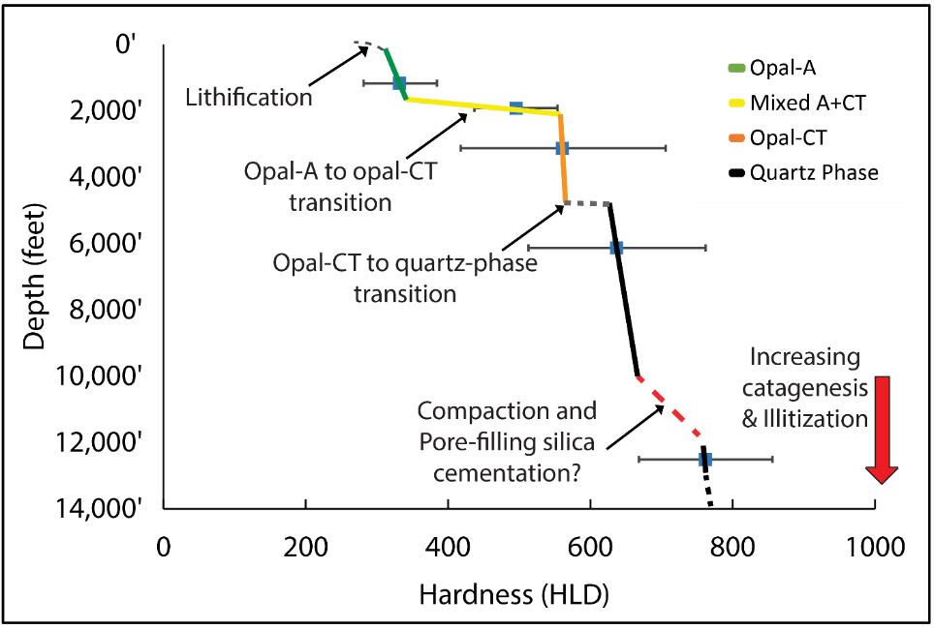
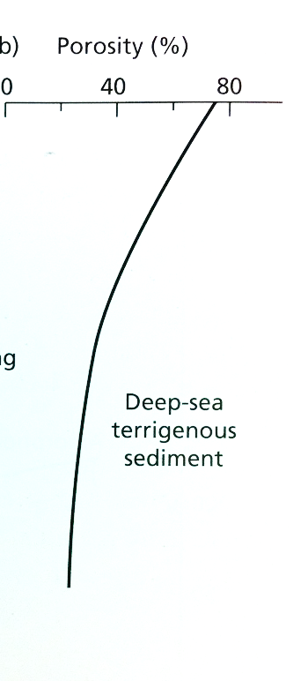
Stepwise Hardening with Diagenesis
Not Gradual Sediment Compaction
Stepwise Shifts in Hardness
Notes:
NOT a standard burial compaction - Important because no geomechanical equations are built to handle complex diagenesis and high porosity

Slide 12
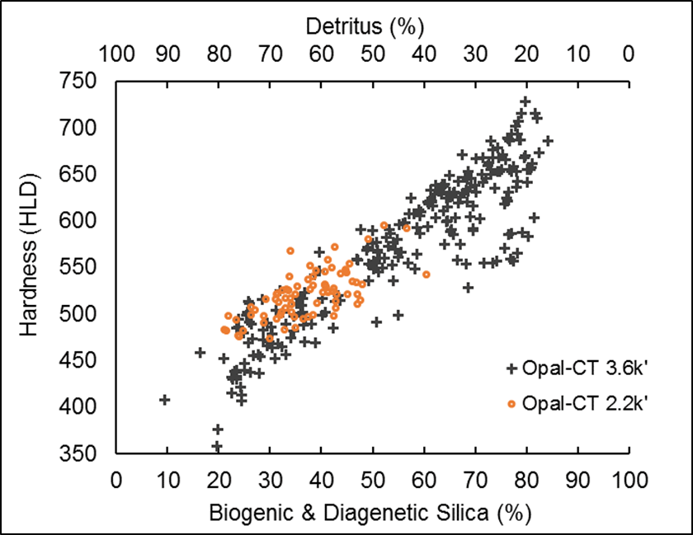
Controls - Burial Compaction
Opal-CT resistance to burial compaction
  Rigid and relatively strong rock with micro-crystalline fabric
No offset = no compaction
Notes:
40% step through opal-CT with no increase in HLD

Slide 13
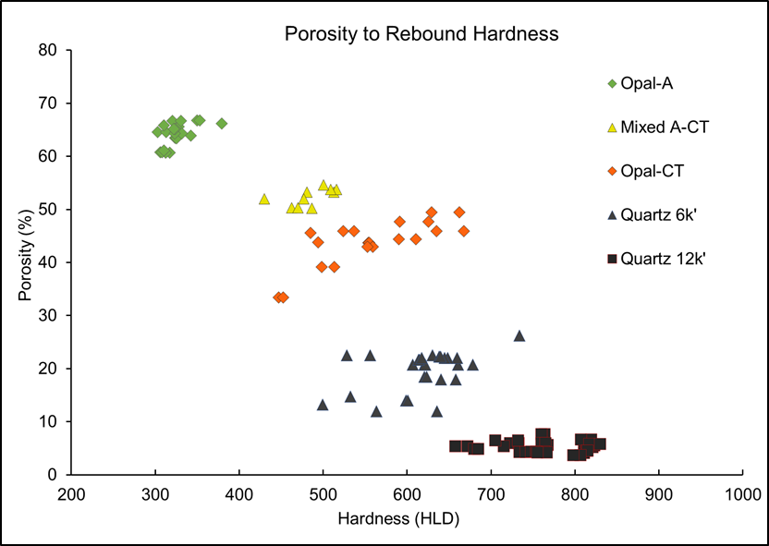

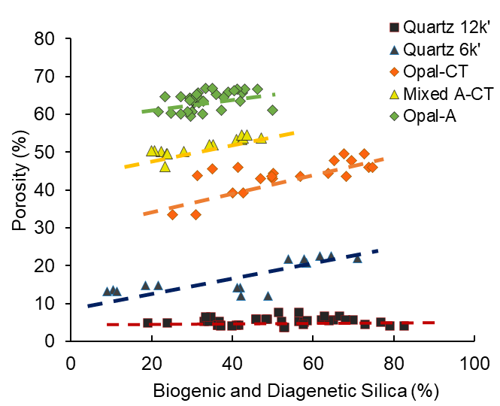
Controls – Porosity and Composition
z
Trend -> Higher porosity in silica-rich rocks
Porosity (%)
Notes:
Estimations of mechanical properties or brittleness is often tied to porosity.
This chart shows standard and unusual behavior of the relationship between porosity and composition.

Slide 14
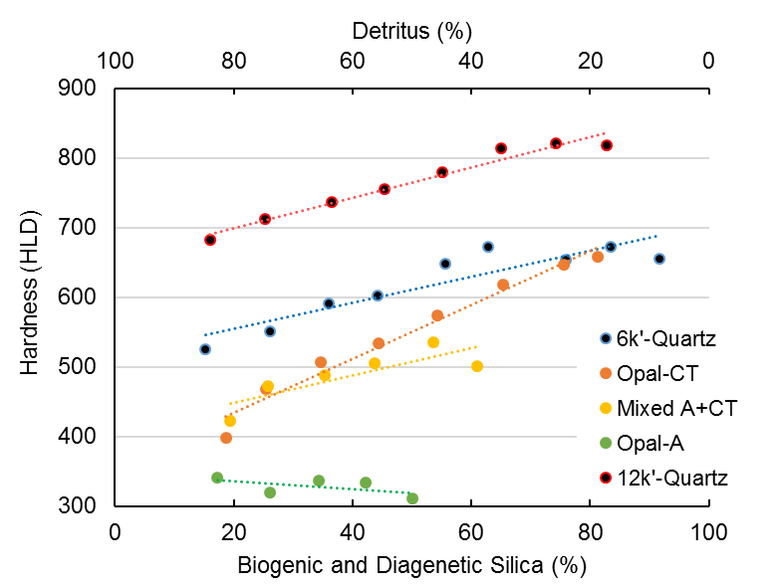
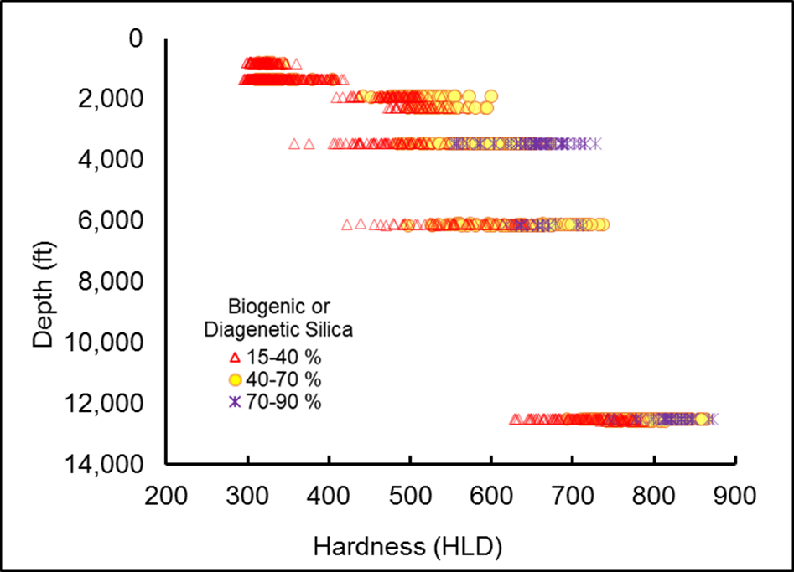
Controls
Composition
Variable Porosity Loss
Silica Diagenesis
Clay Diagenesis
Catagenesis
Variable Physical Compaction
Sample Group | Log Trend of mean HLD points | Correlation of determination (R²)
opal-A | HLD=-0.55 x (% Si) + 346.91 | 0.33
mixed opal-A+CT | HLD= 1.99 x (% Si) + 408.24 | 0.71
opal-CT | HLD= 3.88 x (% Si) + 356.33 | 0.97
6k’-quartz | HLD= 1.86 x (% Si) + 517.38 | 0.83
12k’-quartz | HLD= 2.18 x (% Si) + 655.86 | 0.97

Slide 15
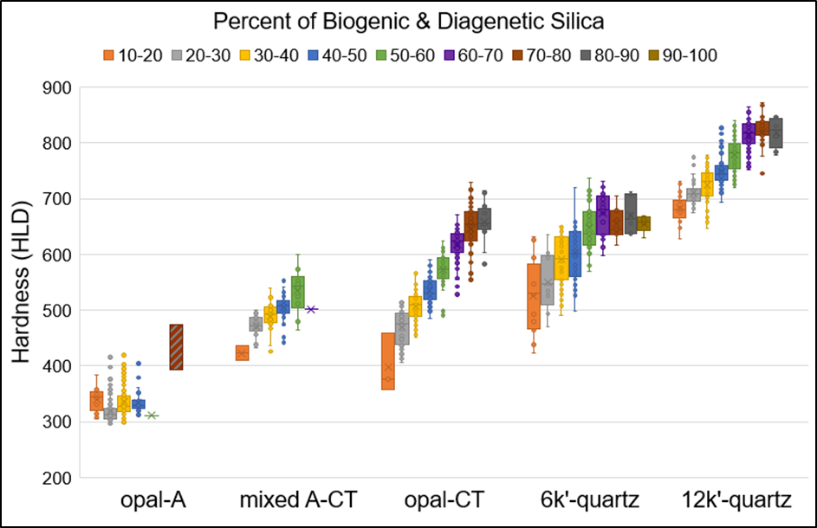
Controls – Composition and Diagenesis
Notes:
Rocks of similar composition are in different silica phases and what aspects of lithologies are becoming harder at variable rates
Catagenesis, OM
I/S

Slide 16
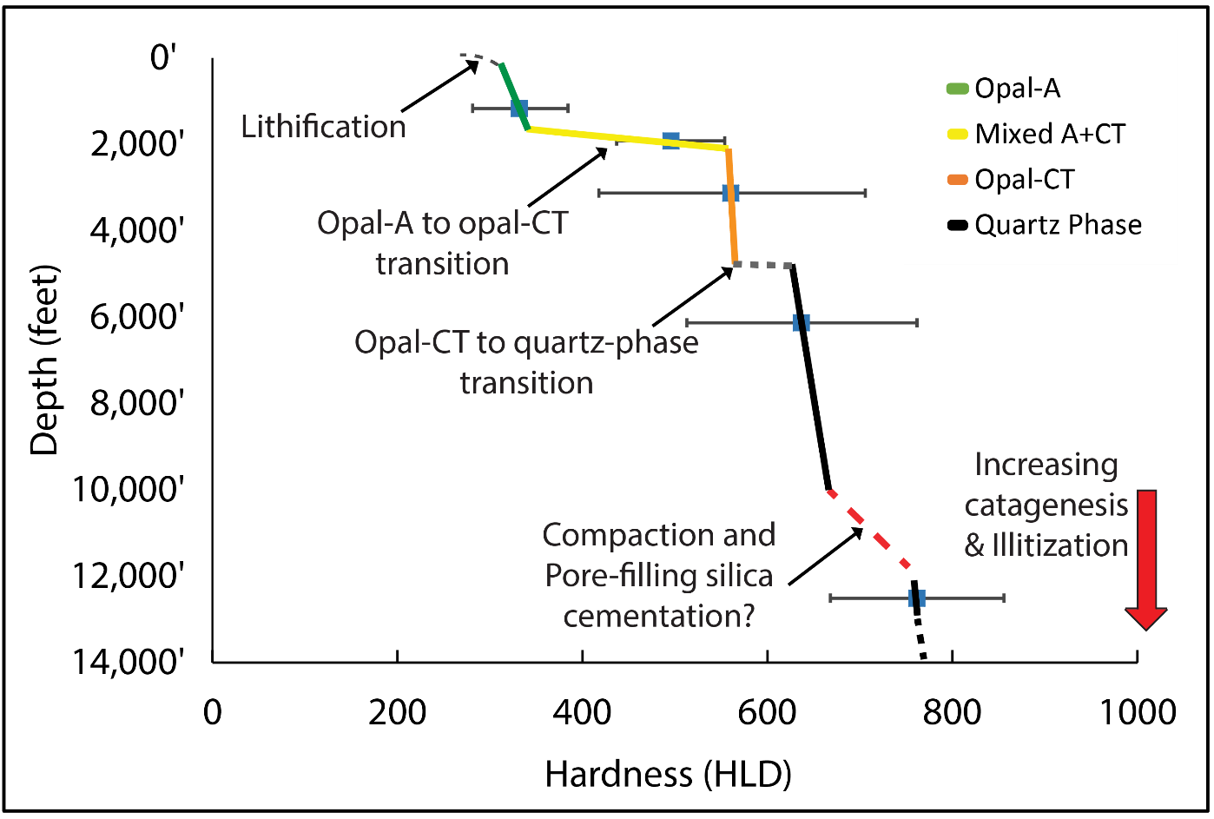
Hardness Variability and Controls
Composition
Variable Porosity Loss
Silica Diagenesis
Clay Diagenesis
Catagenesis
Variable Physical Compaction
Notes:
800-1000’ opal-A sample, 1900’ mixed A&CT samples, 2-4000’ opal-CT samples, and quartz phase samples at 6 and 12 thousand feet.

Slide 17
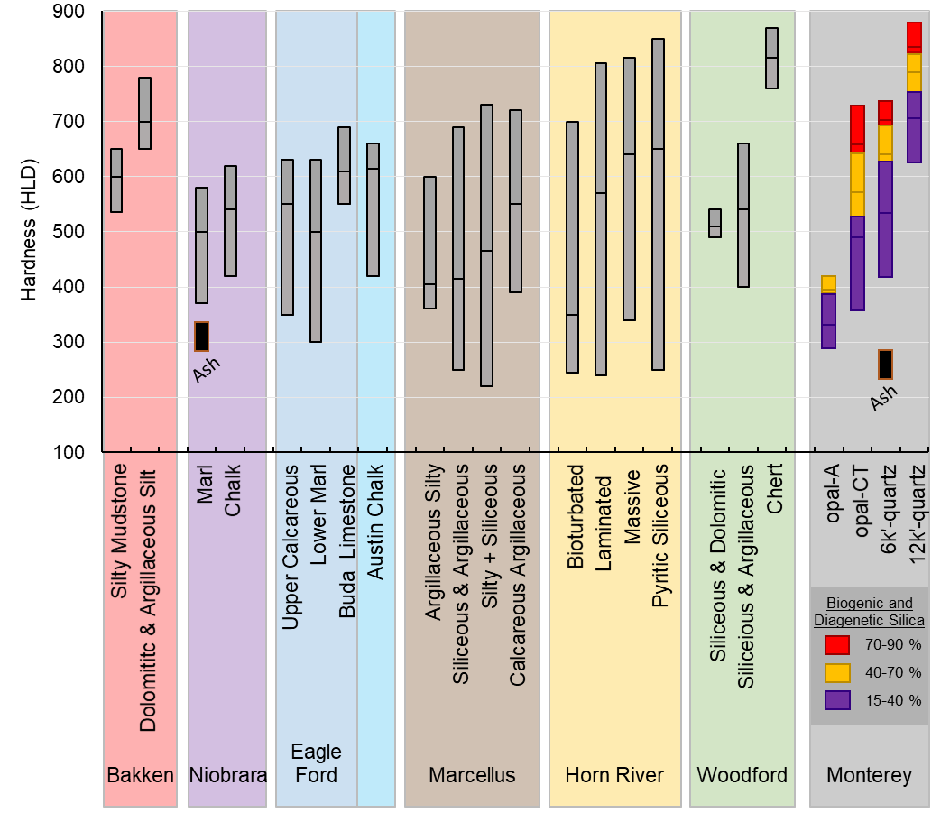
Comparison
Notes:
Aggregated data from 6 other NA Shale plays, broken into lithotypes
Note that in the Monterey, hardness is distributed by composition, and this is similar in other shales
Detritus rich are weakest, this includes ash beds that have altered to bentonite clay.
Carbonate-rich lithotypes - less hard than CT and Quartz phase Monterey, both less than 7,000’ and thermally immature!
Hardest are highly siliceous and deepest buried (GAS)

Slide 18
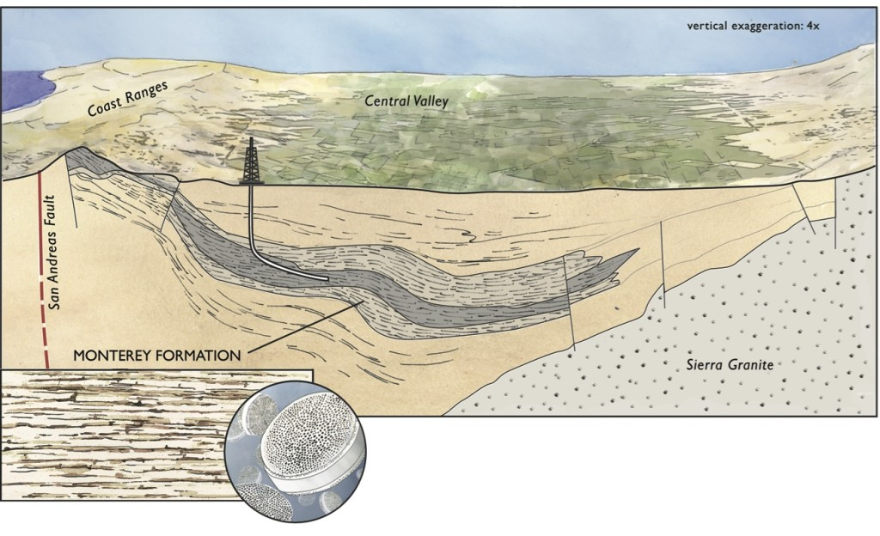
Applications
Drilling Efficiently
  ROP
  AZI and INC drift
Fracture Closure
  Self arresting (breccia)
  Proppant embedment
Wellbore stability
  Casing shear
  Borehole collapse
Fracturability or Frac Design
  Location and extent of induced or natural fractures
  Barriers to
New Play Concepts
  Duel permeability targets

Slide 19
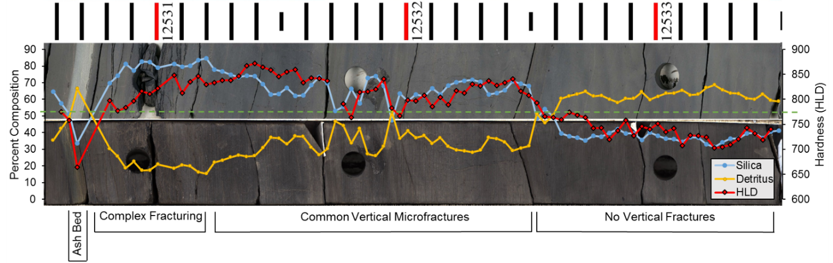
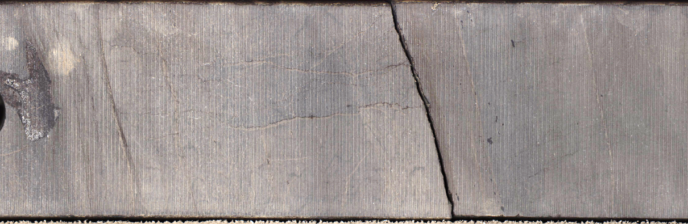
Implications - Failure Criteria

Slide 20

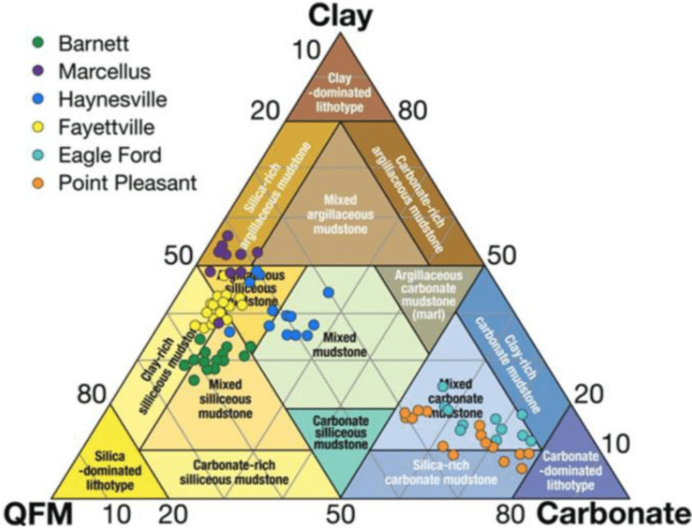
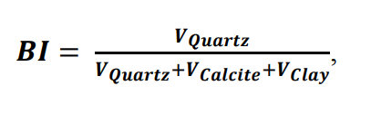
12’k-Quartz
>11,000’ = Higher strength and Heterogeneity
Deep Quartz
  Potentially Very Hard (Fast)… Too Hard?
  Clay-poor (silica-rich) are hardest, fastest, lowest por.
  Generic mineralogical BI is not appropriate
    Highest clay & kerogen-rich rocks are still really hard!
?
Notes:
Monterey is TOO Strong at extreme end
Compared to many other unconventional shales, they are much harder, so Opal-CT is possibly more brittle at shallower depths; but also 12k’-quartz is much harder, maybe too hard?

Slide 21
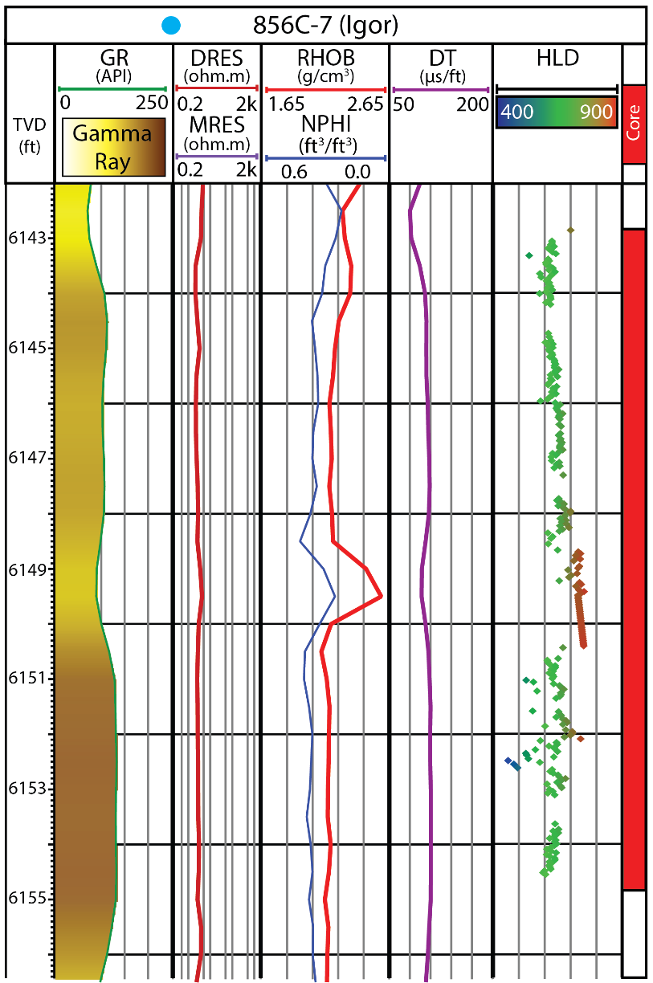
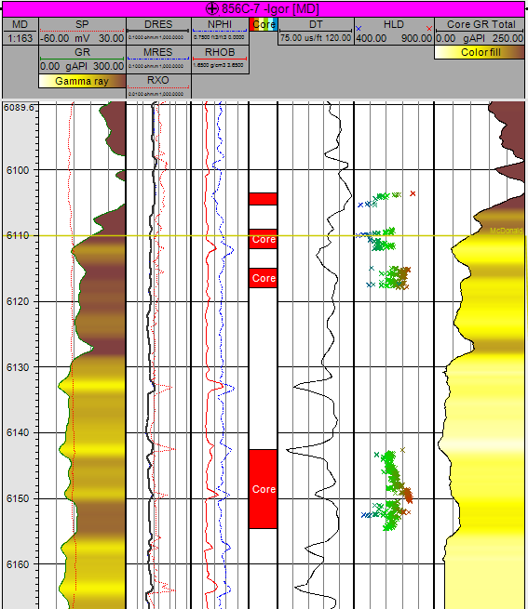
HLD to Wireline Resolution

Slide 22
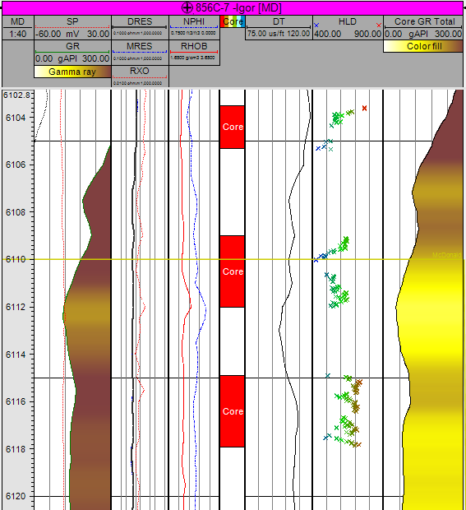
HLD to Wireline Resolution

Slide 23
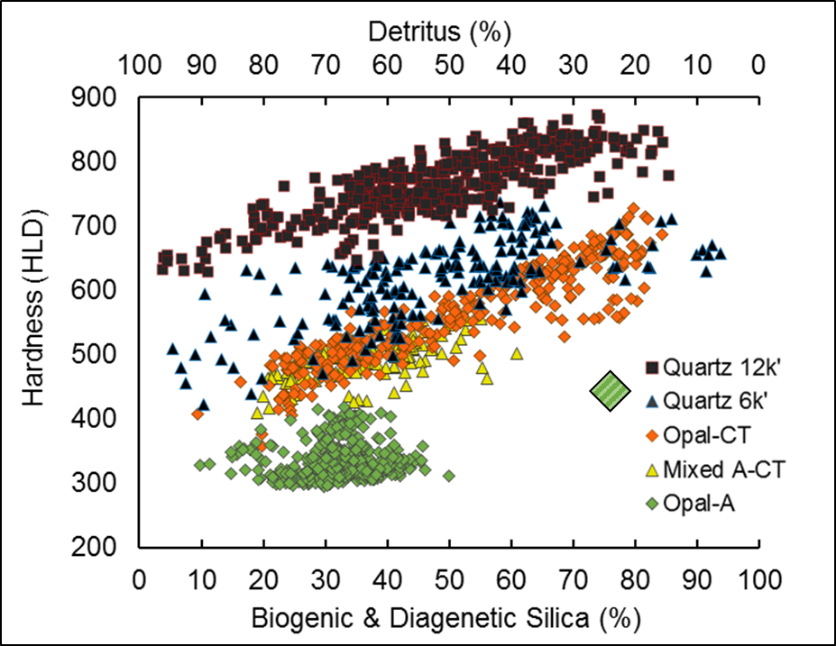
Summary
Strong trends with composition
  Can be correlated to spectral GR
  Inconclusive Opal-A
Quantified Diagenetic hardening
  Opal-A to mixed A+CT is greatest
  Opal-CT resistance to compaction
  Opal-CT to Quartz is lesser
Porosity is too complex for simple geomechanical guidance
Distinct character of deep and cemented quartz phase rocks

Slide 24
Summary
Hardness by
  Detritus Content
  Silica Mineralogy
  Burial Depth / Thermal Maturity
Measurable and mappable
  GR correlation
  Play Concept and Exploration Potential
Historical strength and basin modeling
Fundamental differences to other shale plays
Future Work
Illite/Smectite
Pure cherts & diatomite
Pressure and temperature
Match to drilling parameters
SEM and thin section analysis
Natural fracture timing
Texture, fabric, micro-porosity
Dolomite and pyrite
Ideas?

Slide 25
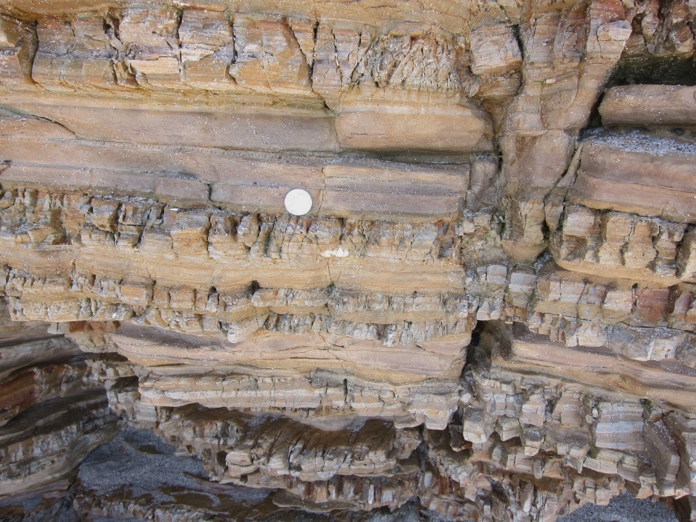
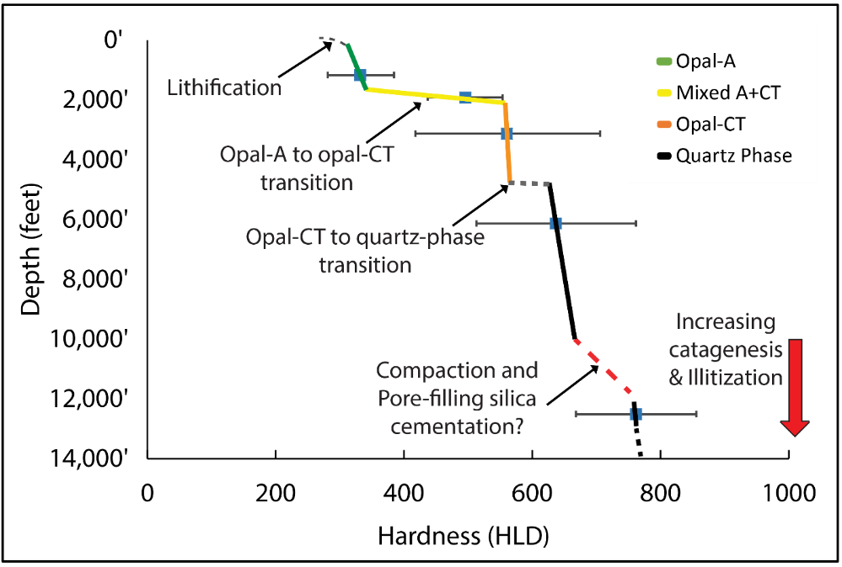
Questions and Discussion
Near Point Sal Beach, CA. Jointed opal-CT porcelanite and unfractured siliceous mudstone; quarter (25₵) for scale.
Thanks to the MARS Project supporters for data, core access, the Proceq rebound hardness tester, and guidance.
Thanks to my committee and CSULB colleagues.

Slide 27
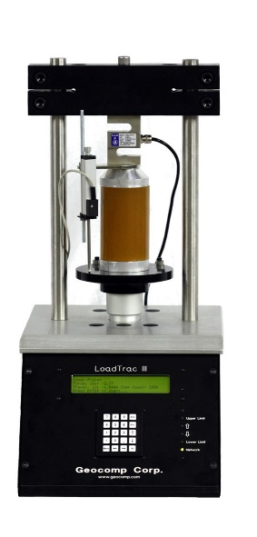
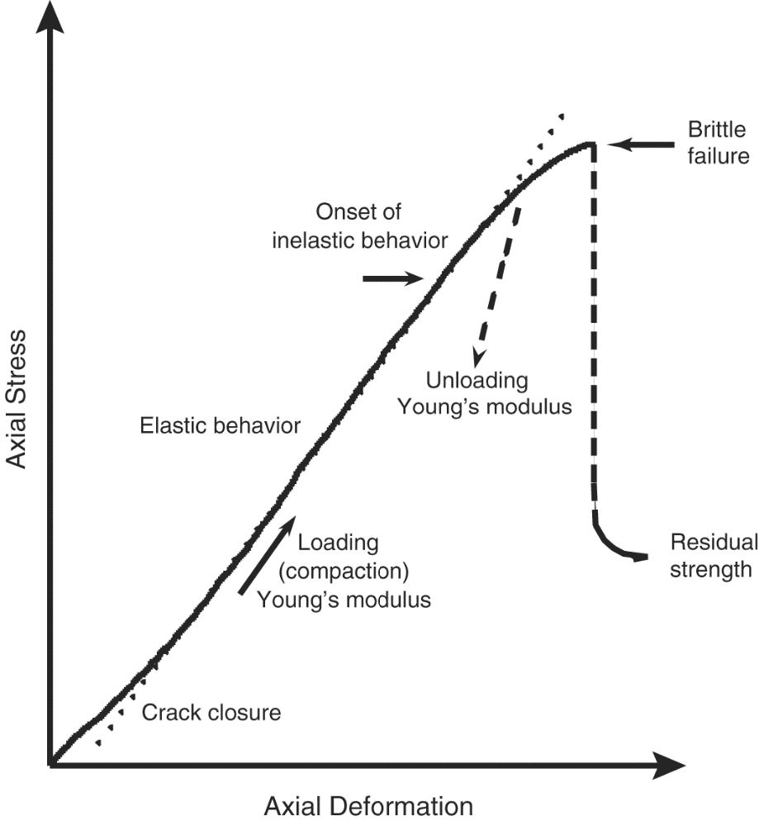
Unconfined Compressive Strength - UCS
Stress loading to brittle strain (brittle failure)
Close relationship to elasticity (Young’s Modulus)
AKA uniaxial compressive strength
Lee et al. (2014) added shale to established conversion:
rebound hardness –> UCS
www.geocomp.com

Slide 28
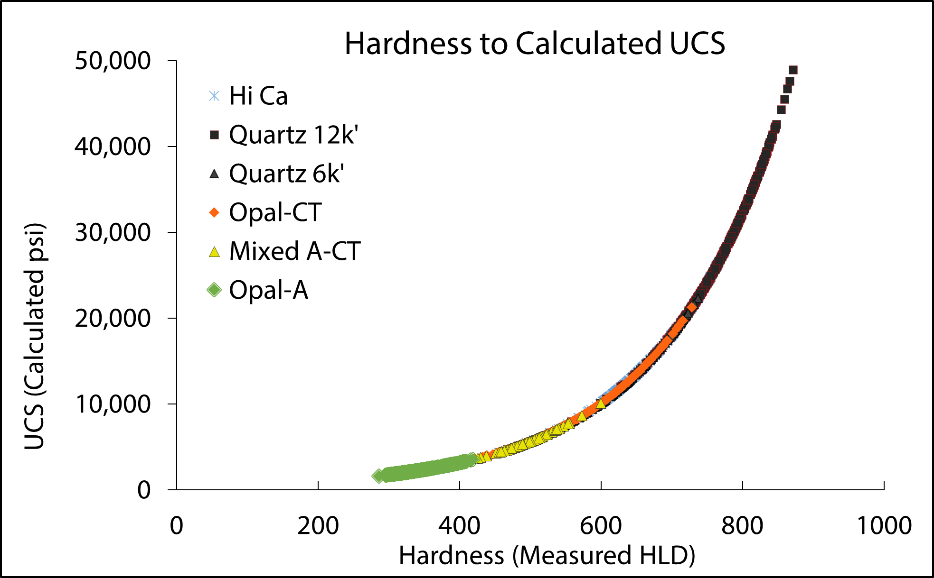
Rebound Hardness to UCS conversion
Modified from Lee et al. (2014)
Applied Lee et al. (2014) literature trend line to Monterey Formation HLD
Measured diatomite UCS (800-1485psi)
(Strickland 1985, Hansen and Purcell 1989, Bruno and Bovberg 1992)
Measured CT UCS (4,000-7,500psi)
Measured QTZ 5k’ UCS (8,000- 13,000 psi)
(TeraTek)
Measured QTZ 12k’ UCS (18,200 – 30,300psi)
(Core Labs)
Notes:
Monterey lithologies have a range of rock strengths that span most sedimentary and igneous rock types.
If your reservoir was mixed granite, limestone and shale, you would definitely take rock mechanics into serious consideration.

Slide 29
USC (MPA vs PSI)

Slide 30
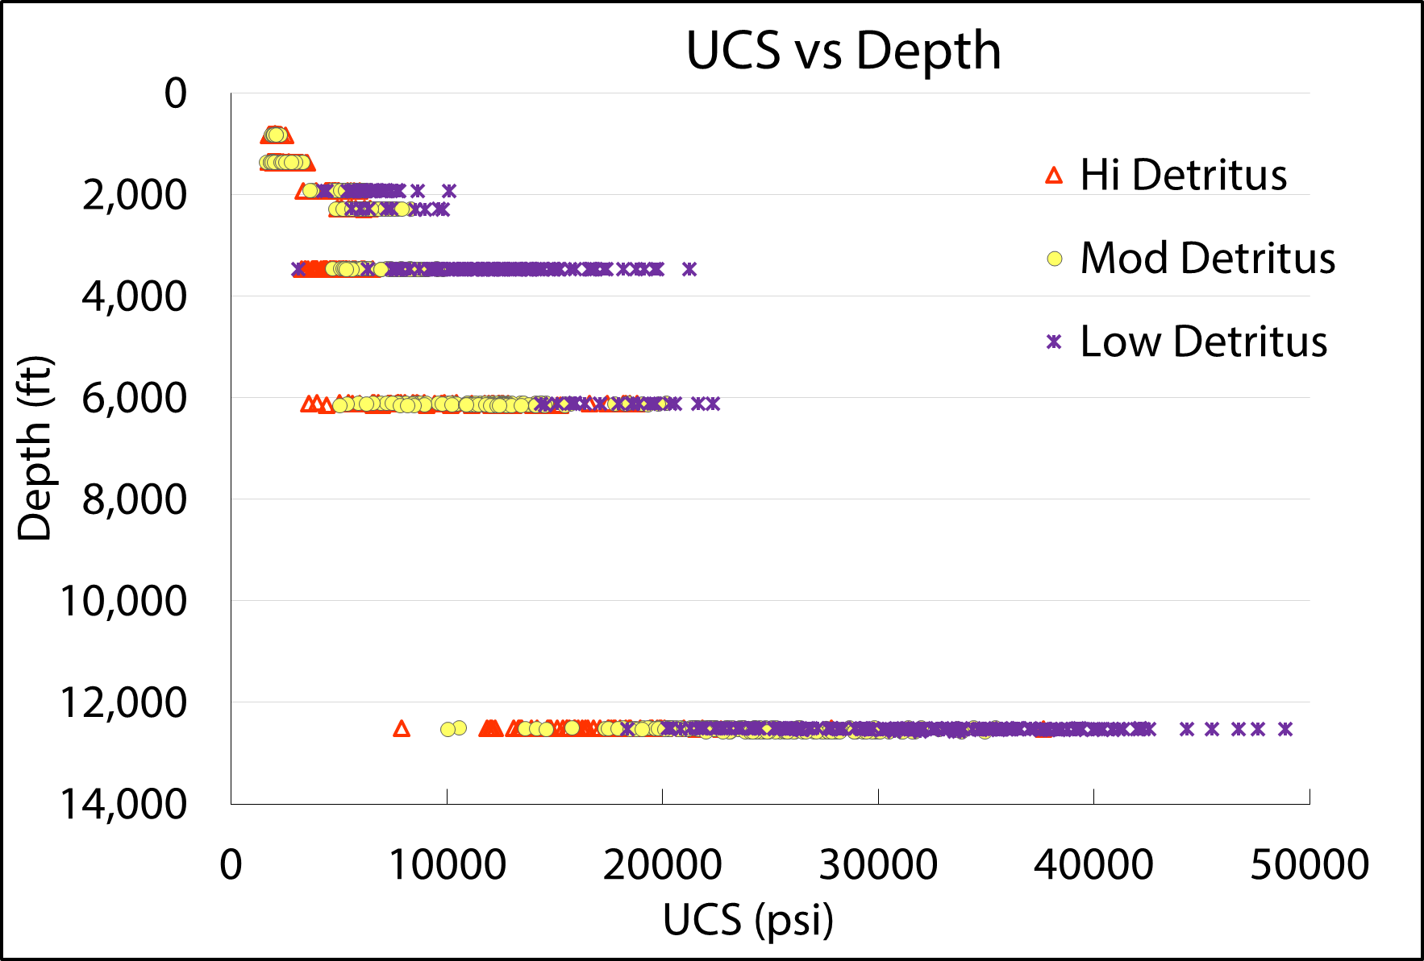
Comparably Higher Rock Strength
Marcellus Shale
Bakken (Mid)
Barnett
Haynesville
Eagle Ford
Muderrong Shale
*Calculated UCS
Notes:
A 15,000psi variance in CT and quartz by composition alone
The Marcellus the Austin Chalk, the Eagle Ford….
2 Things (these weak rocks are FRACTURABLE) (and most of our Monterey rocks are SHALLOWER, with less confining pressure)

Slide 31
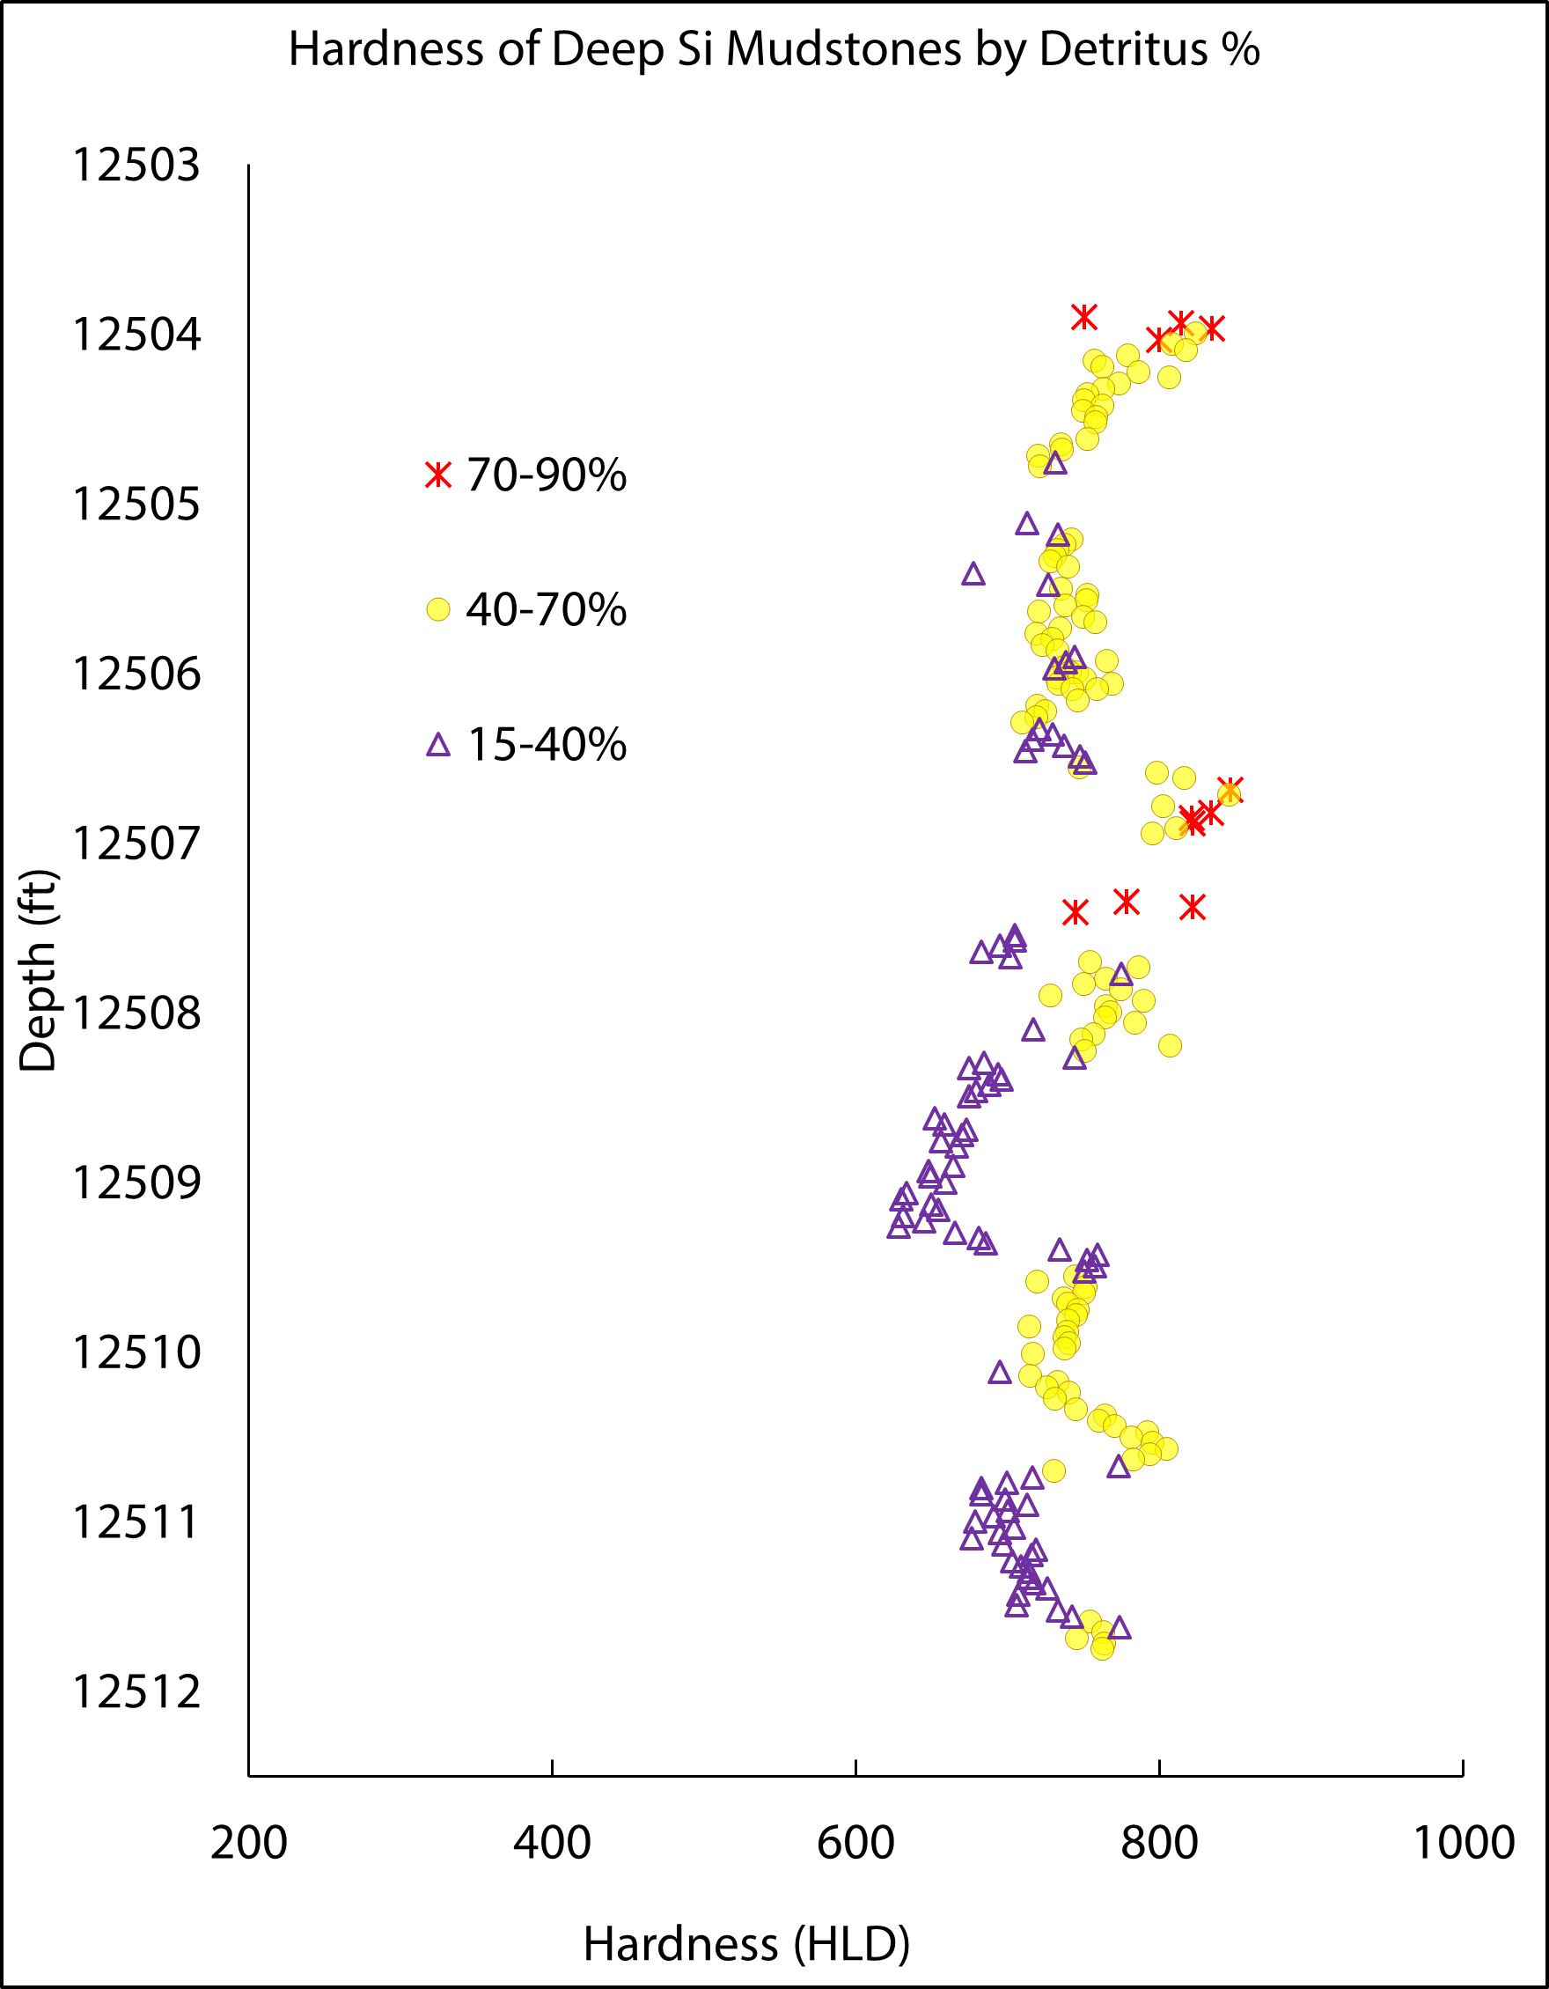
Hardness Results
Good agreement with compositional variance
High resolution hardness in compositional groups
Biogenic or diagenetic Silica
Length 3.2ft

Slide 32
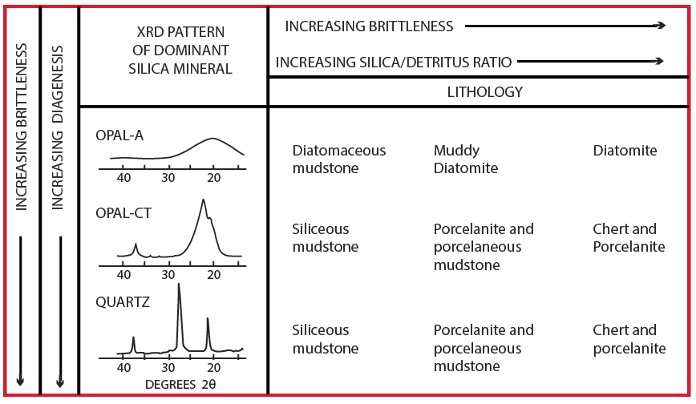
Silica Diagenesis + Nomenclature

